Slide 1

CSE 3121
Database Management Systems
Session: 2016-17
Dr. Asif Zaman
Associate Professor, CSE, RU
Week # 1

Slide 2
Instances and Schemas
Databases change over time: information is inserted and deleted.
The collection of information stored in the database at a particular moment is called an instance of the database.
The overall design of the database is called the database schema.
Schemas are changed infrequently, if at all.

Slide 3
Data Models
Data model: a collection of conceptual tools for describing data, data relationships, data semantics, and consistency constraints.
A data model provides a way to describe the design of a database at the physical, logical, and view levels.
The data models can be classified into four different categories:
Relational Model.
Entity-Relationship Model.
Object-Based Data Model.
Semi structured Data Model.

Slide 4
Data Models
Relational Model.
The relational model uses a collection of tables to represent both data and the relationships among those data.
Each table has multiple columns, and each column has a unique name.
Tables are also known as relations.
The relational data model is the most widely used data model, and a vast majority of current database systems are based on the relational model

Slide 5

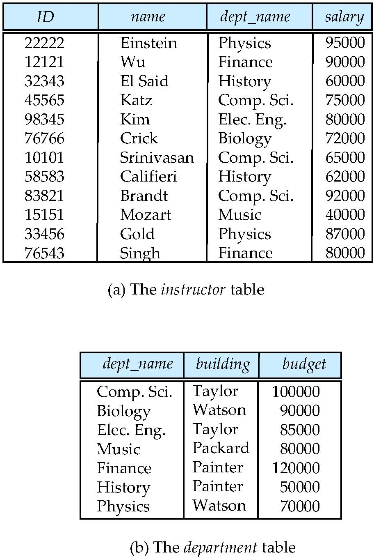
Relational Model
Ted Codd
All the data is stored in various tables.
Example of tabular data in the relational model
Columns
Rows
Notes:
5

Slide 6
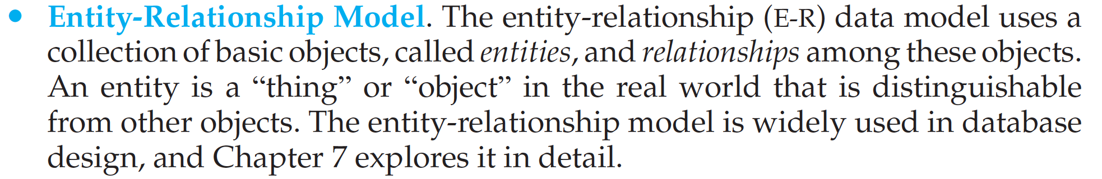
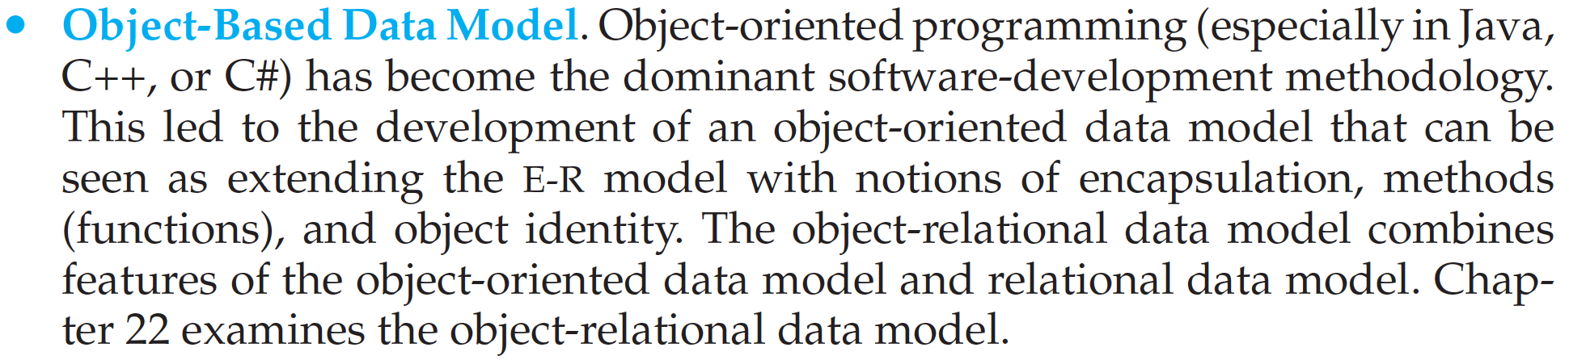
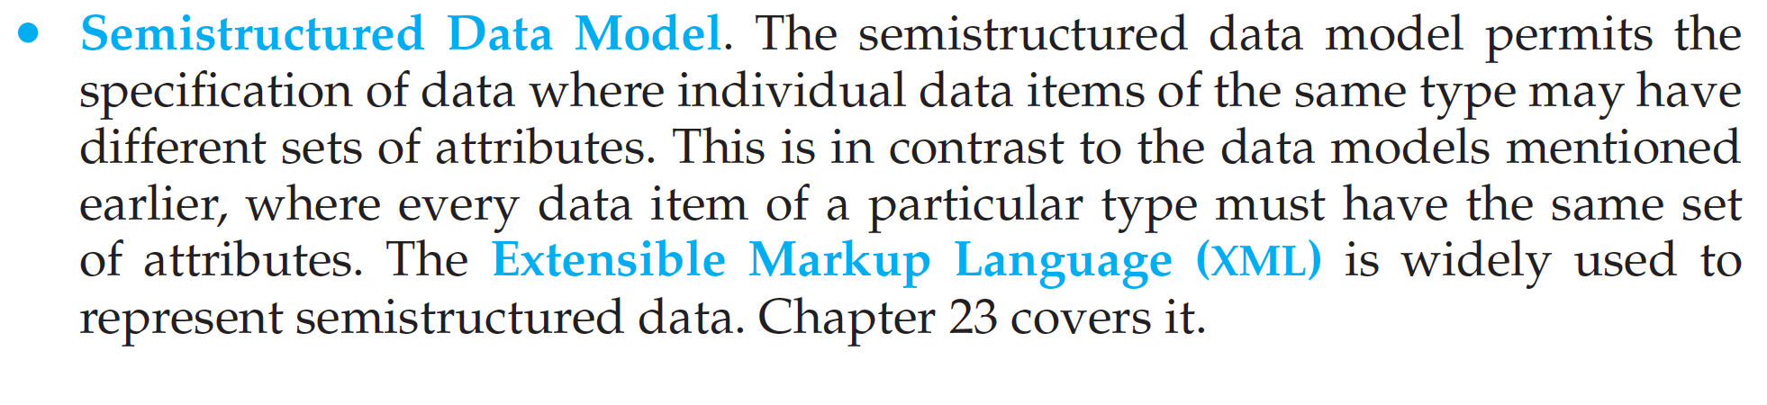

Slide 7
Database Languages
A database system provides a data-definition language (DDL) to specify the database schema.
A data-manipulation language (DML) to express database queries and up-dates.
In practice, the data-definition and data-manipulation languages are not two separate languages; instead they simply form parts of a single database language, such as the widely used SQL language.

Slide 8
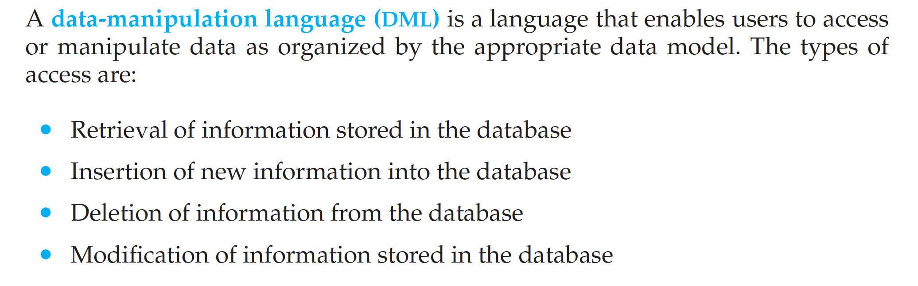
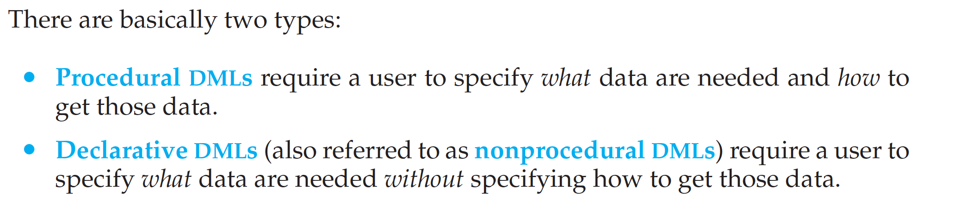
Data-Manipulation Language

Slide 9
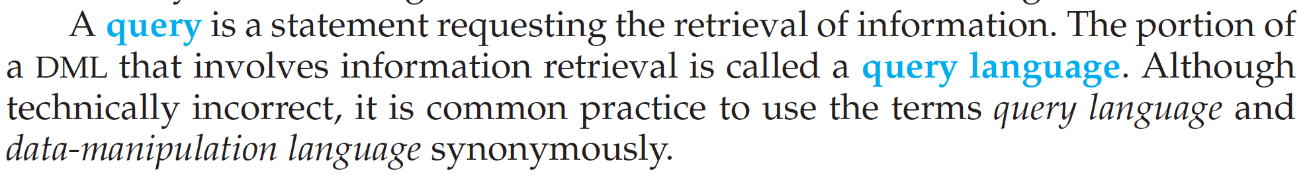
Data-Manipulation Language
Query:

Slide 10
Data-Definition Language
We specify a database schema by a set of definitions expressed by a special language called a data-definition language(DDL).
The DDL is also used to specify additional properties of the data.
E.g. some constrains like value cannot be ‘-ve’ costly.
Database systems implement integrity constraints that can be tested with minimal overhead:
Integrity- the quality of being honest
Constraints - restriction

Slide 11
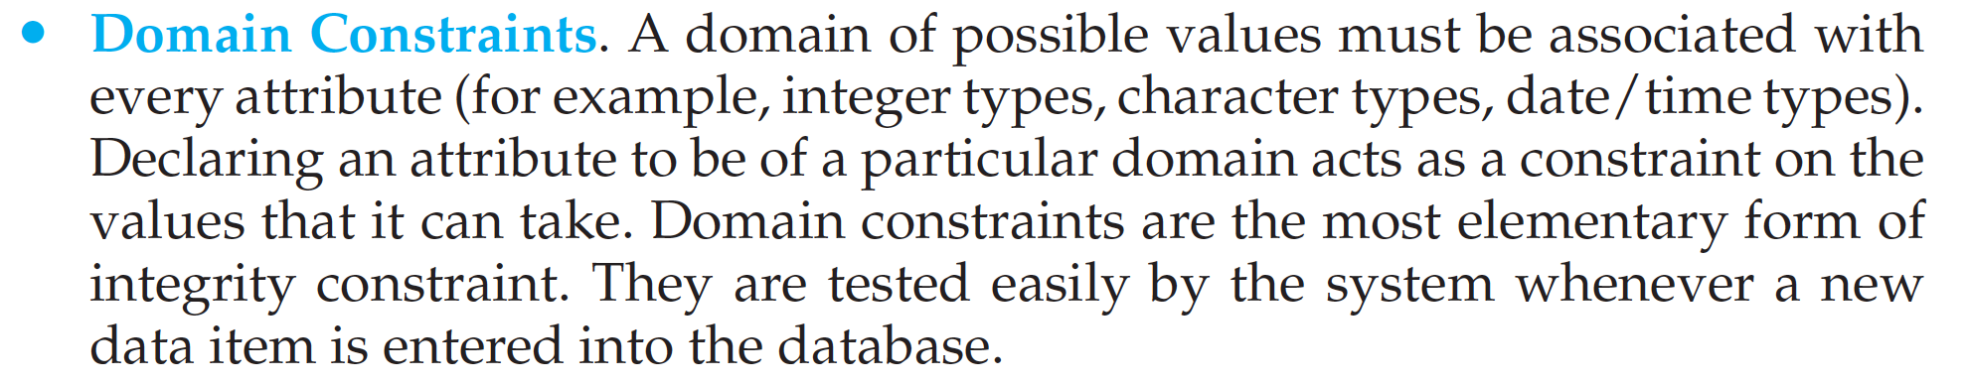
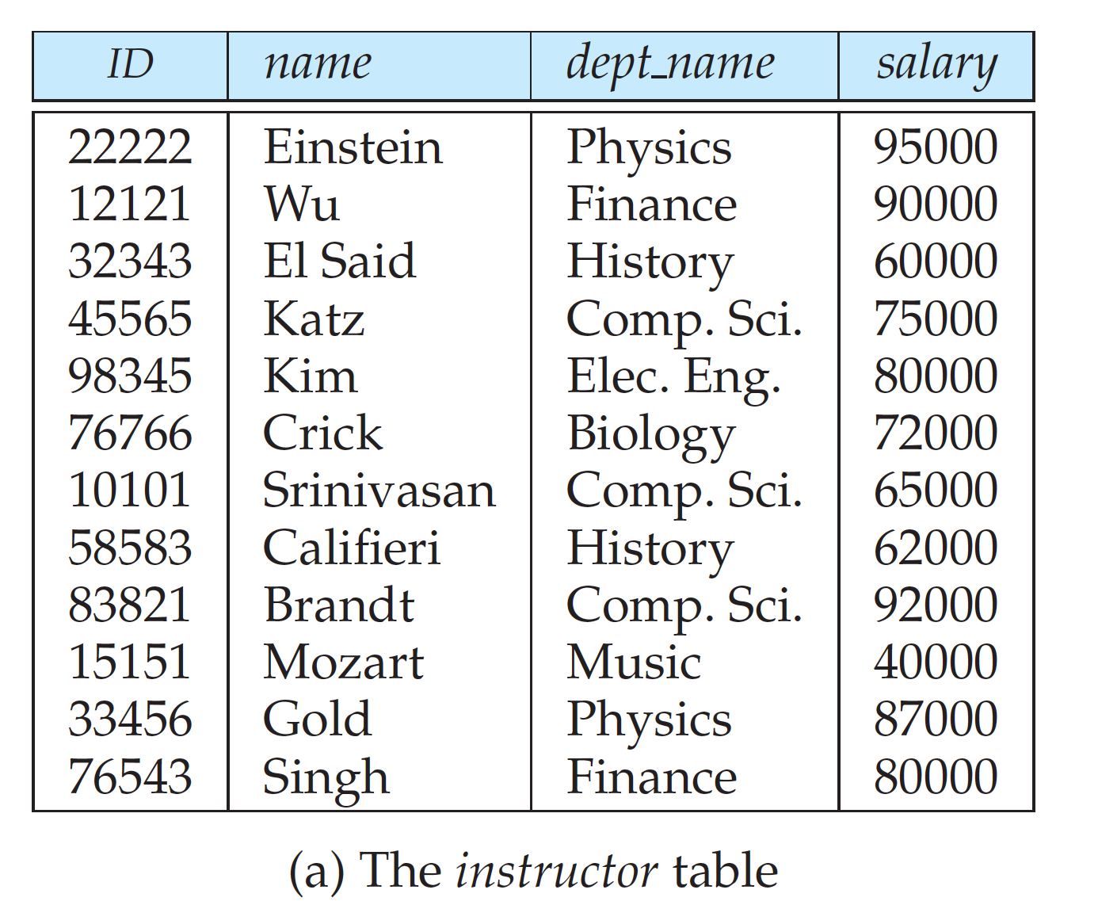
Integrity Constrains

Slide 12
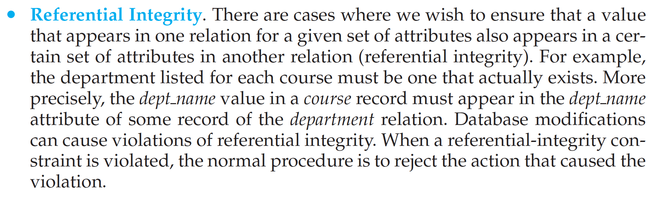
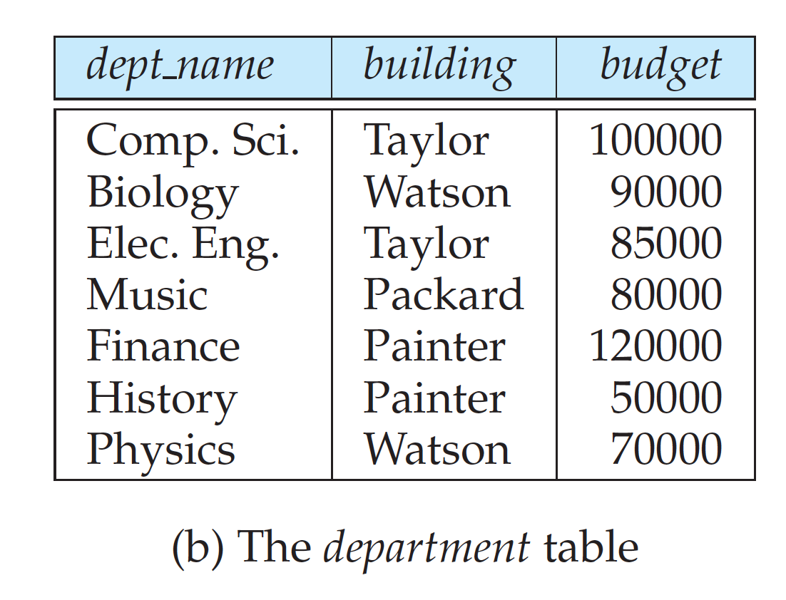
Integrity Constrains

Slide 13
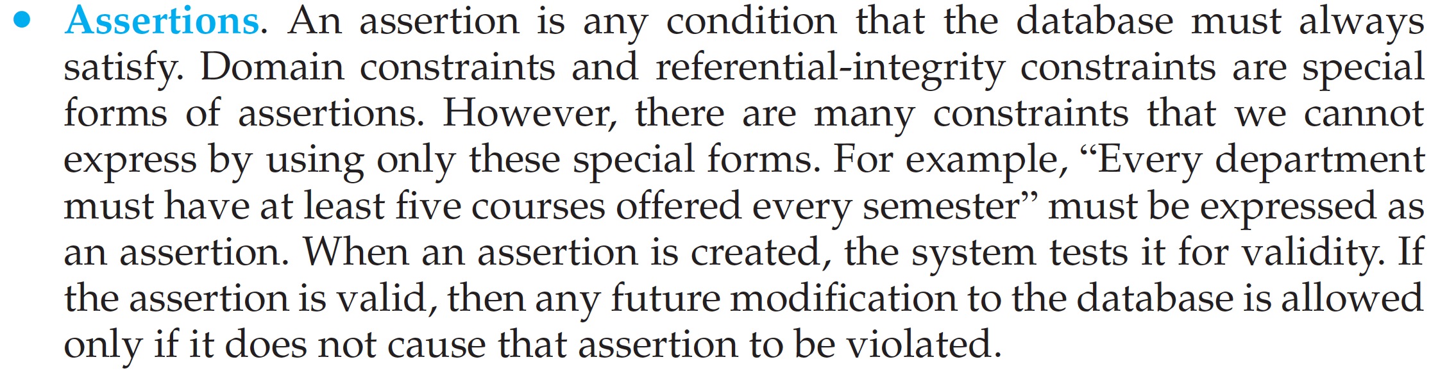
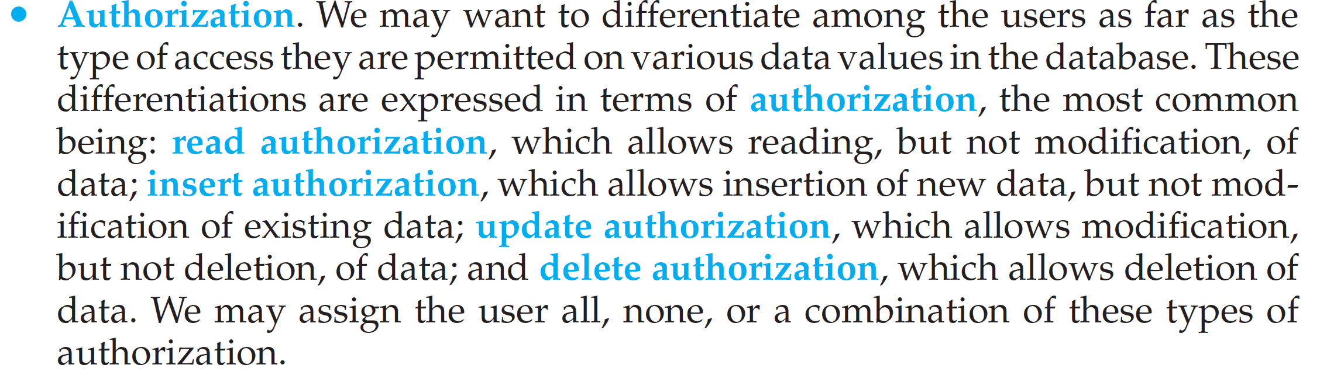
Integrity Constrains

Slide 14
Data-Definition Language
The DDL, just like any other programming language, gets as input some instructions (statements) and generates some output.
The output of the DDL is placed in the data dictionary, which contains metadata—that is, data about data.
The data dictionary is considered to be a special type of table that can only be accessed and updated by the database system itself (not a regular user).
The database system consults the data dictionary before reading or modifying actual data.

Slide 15
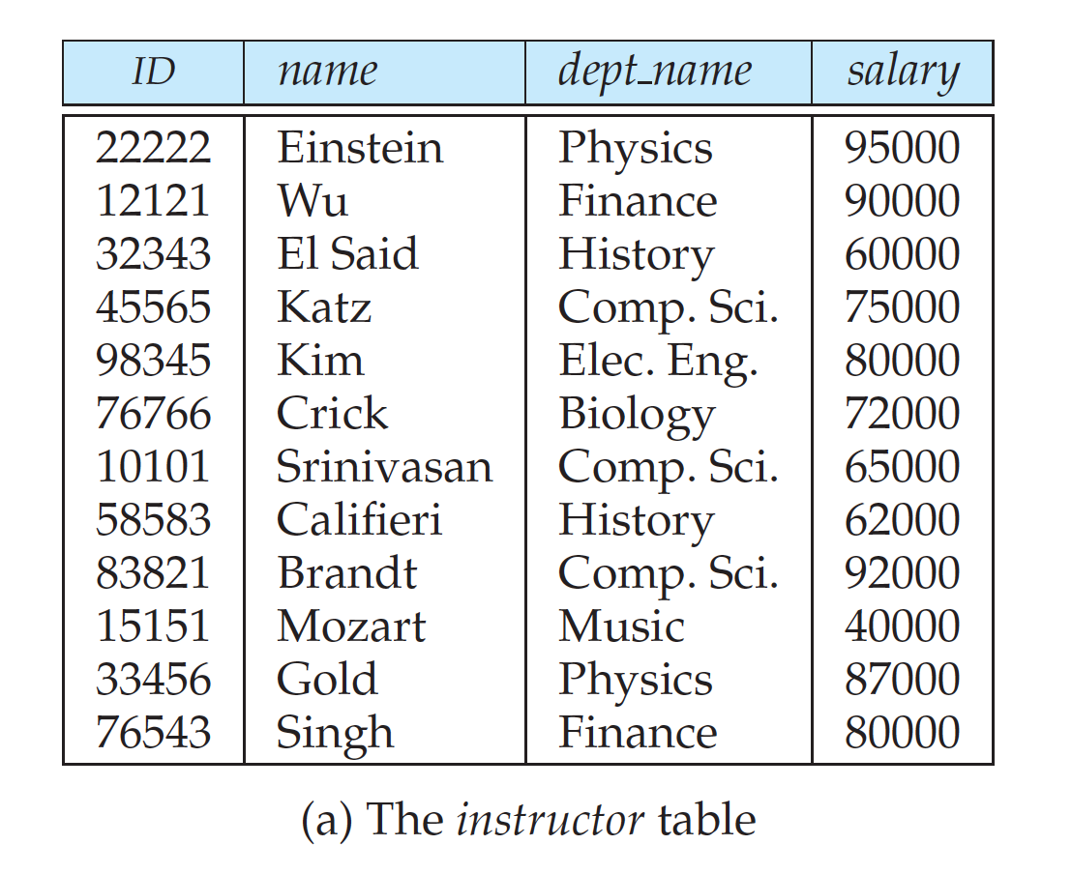
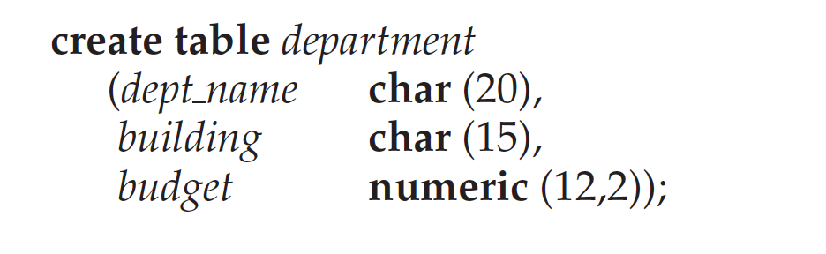
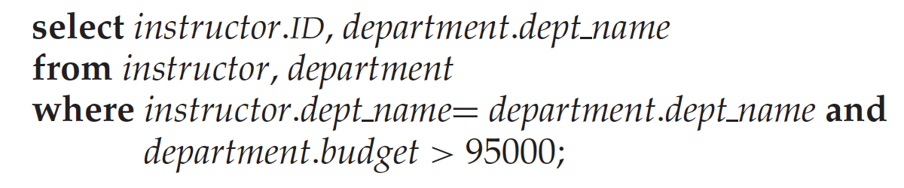
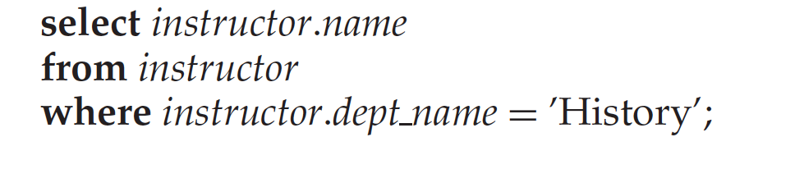
#DML:

Slide 16
Database Design
Database design mainly involves the design of the database schema.
The design of a complete database application environment that meets the needs of the enterprise being modeled requires attention to a broader set of issues.
The database designer needs to interact extensively with domain experts and users to carry out this task.
The outcome of this phase is a specification of user requirements.
Next, the designer chooses a data model, and by applying the concepts of the chosen data model, translates these requirements into a conceptual schema of the database.

Slide 17
Database Design
The designer can also examine the design to remove any redundant features.
The focus at this point is on describing the data and their relationships, rather than on specifying physical storage details
In terms of the relational model:
the conceptual-design process involves decisions on what attributes we want to capture in the database and how to group these attributes to form the various tables
The “how” part is mainly a computer-science problem.

Slide 18
Database Design
There are principally two ways to tackle the problem:
The first one is to use the entity-relationship model;
the other is to employ a set of algorithms (collectively known as normalization) that takes as input the set of all attributes and generates a set of tables.
A fully developed conceptual schema indicates the functional requirements of the enterprise.

Slide 19
Database Design
In a specification of functional requirements, users describe:
the kinds of operations (or transactions) that will be performed on the data.
Example operations include:
modifying or updating data, searching for and retrieving specific data, and deleting data.
At this stage of conceptual design, the designer can review the schema to ensure it meets functional requirements.

Slide 20
Database Design
The process of moving from an abstract data model to the implementation of the database proceeds in two final design phases:
The Logical-Design Phase, the designer maps the high-level conceptual schema onto the implementation data model of the database system that will be used.
The designer uses the resulting system-specific database schema in the sub sequent Physical-design phase, in which the physical features of the database are specified.

Slide 21
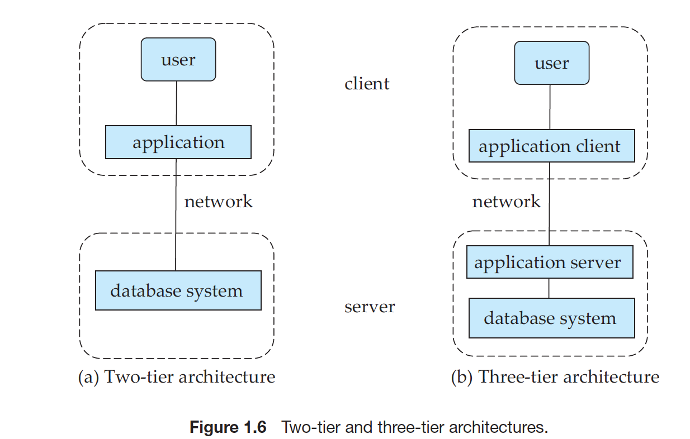
2-Tier & 3-Tier Architectures

Slide 22
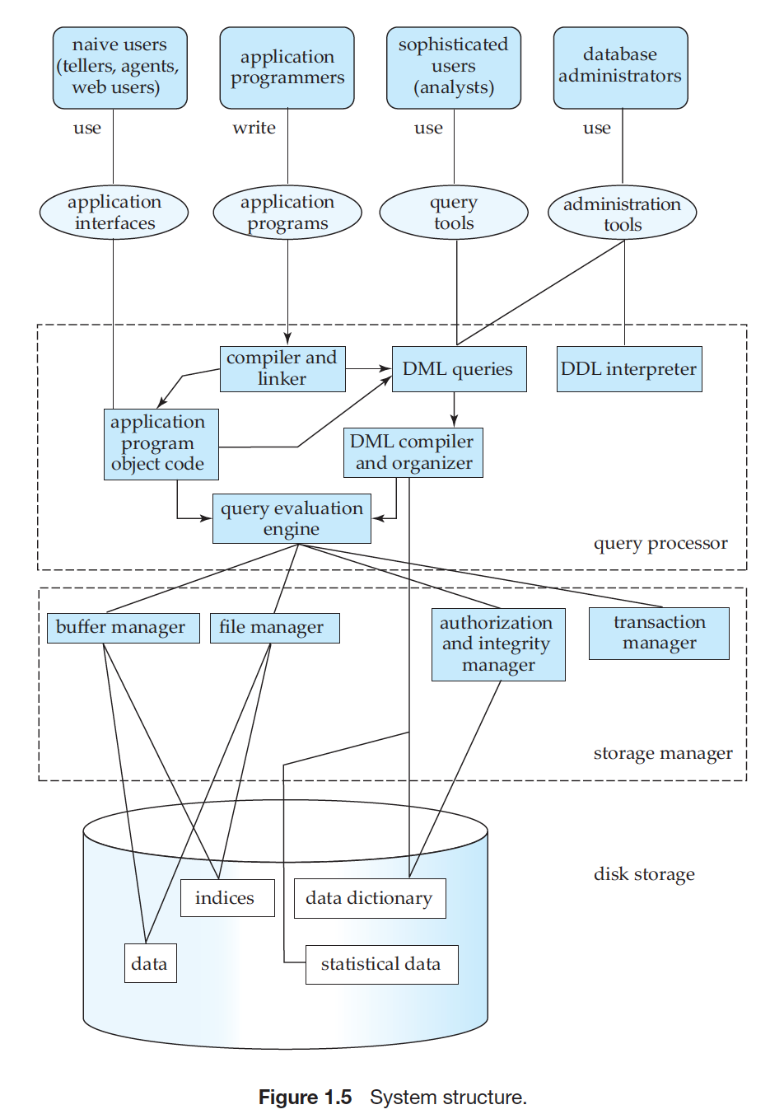

Slide 23
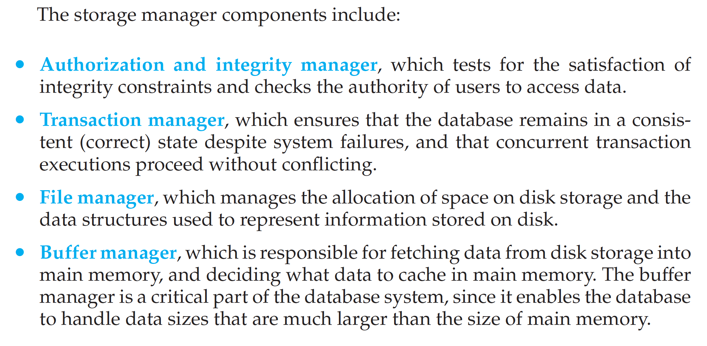
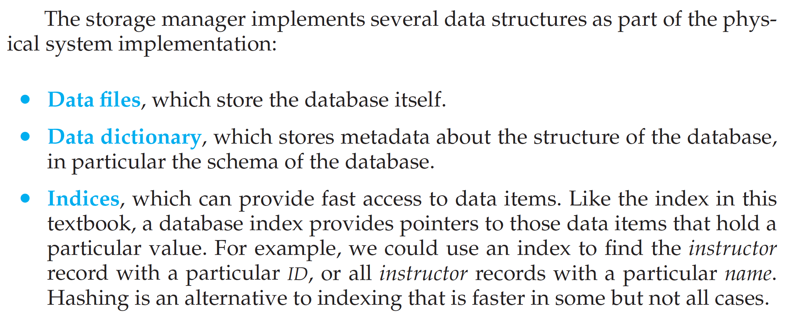
The functional components of a database system can be broadly divided into the:
storage manager and
the query processor components.

Slide 24
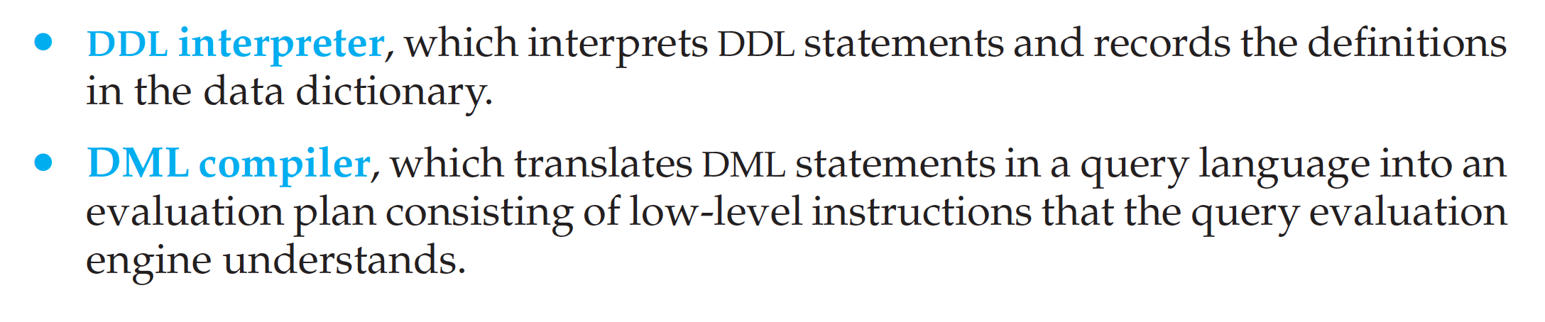
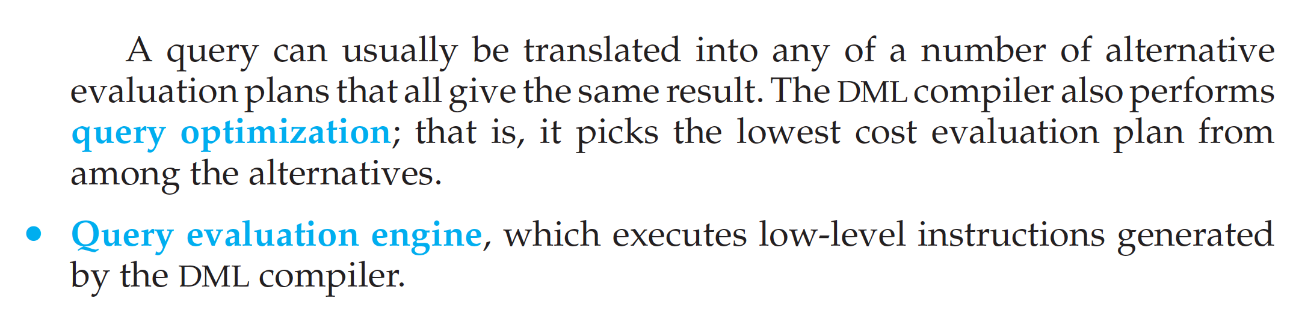

This all-or-none requirement is called atomicity

